Slide 1
Welcome to
Membership Development Program
Membership – The Heartbeat of our Organisation

Slide 2
Video Clip 1

Slide 3

Introduction
Congratulations for been appointed as the membership chairperson
Your part of the Global Action Team(GAT) where the President will serve has the chairperson.
Lions are here to serve, it is what drives them. It is their motivation.
In order to serve, Lions must have the membership to sustain their service
Members must grow into the leaders that guide the service projects that bring in new members, And from these new members, potential leaders emerge.
.

Slide 4
Structure of Lions Clubs International
Lions Clubs International is comprised of a large network of Lions, with clubs at the center. This structure facilitates communication and promotes service on a local, regional and global scale.
1
Club

Slide 5
Club Membership chairperson
Recruitment and retention are the essentials of a successful membership chairpersons development action plan
Develop and lead a membership committee to help implement action plans to achieve the club membership goals
Encourage all members to participate in membership growth by inviting prospective members to the club
Engage new members in activities that are of interest to the members
Ensure that new members are provided with effective orientation so new members will understand how the club operates with in its district, multiple and lions club international
Understand the different membership types and programs offered and promote membership to club members
Attend the district governors advisory committee meeting of the zone in which the club is located

Slide 6
Different membership types
Regular Member
Family Member
Student Members
Leo Lion Members
Former Leo member

Slide 7
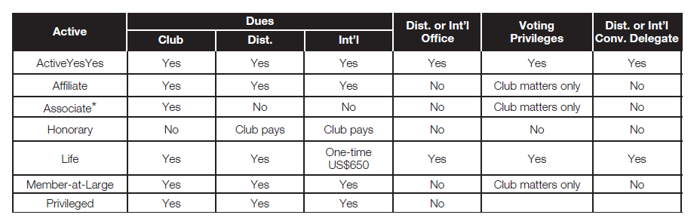
Membership Categories
Active member
Affiliate Member
Associate Member
Honorary Member
Life member
Member – at – large
Privilege member

Slide 8
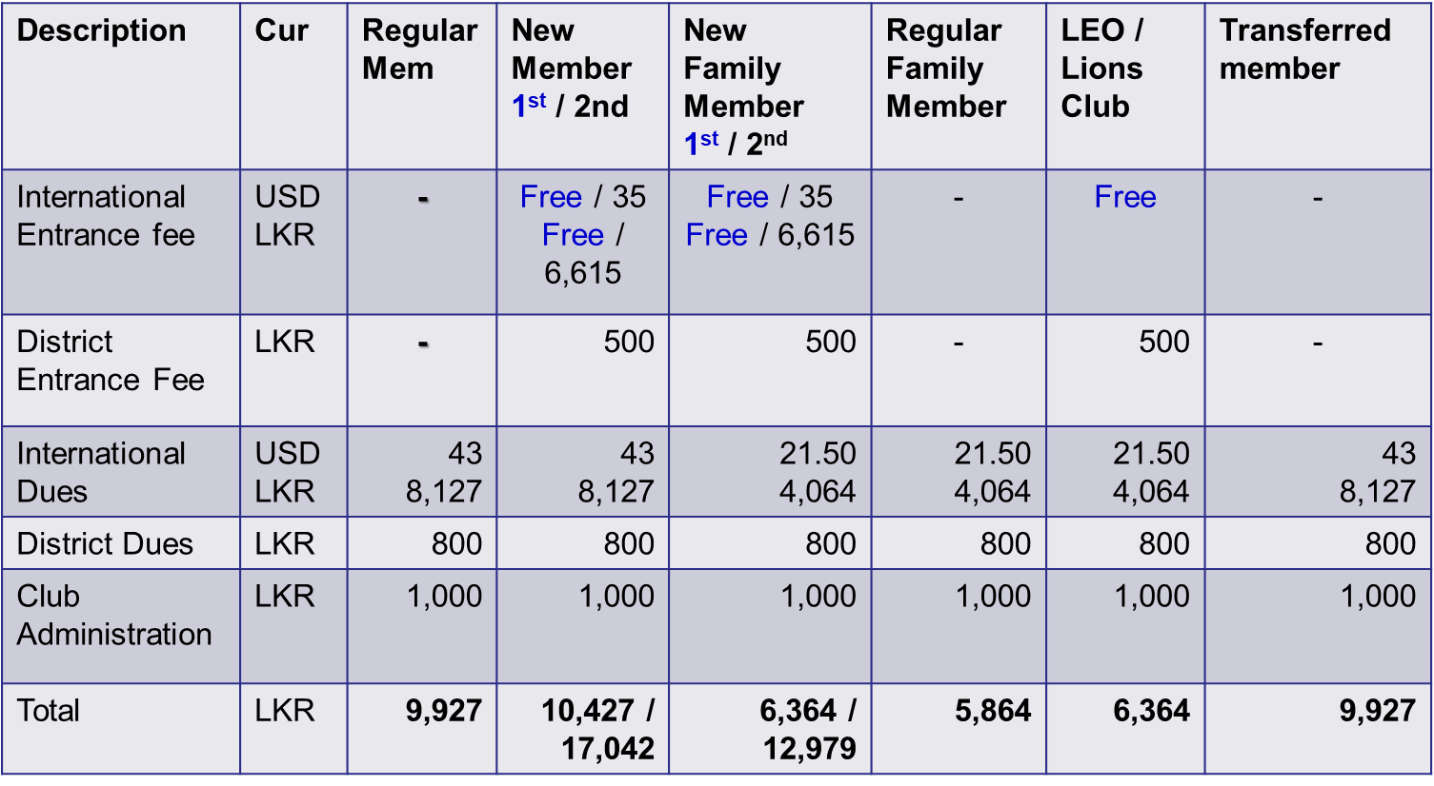
International & District Dues

Slide 9
Video 2

Slide 10
Maximizing Member Retention
Retaining Good members as critical to long – term growth
Knowing how long members remain in your club help you identify your club’s Strengths and weakness in retaining members and tailor your club’s retention strategies
Interviewing Club members – even those who are leaving can help clubs identify why members either stay in or leave a club
Resining member Questionnaire - The resining member Questionnaire should be completed whenever a member choose to leave a club it will help the club prevent such loose in the future.
Education is primary means of retaining club members (examples Club officers training RLLI ALLI)
Encourage members to take part in the service projects organized by the clubs and the District
Post Corvid – Have a plan to retain the membership and club

Slide 11
District Membership plan for 2020/21
District Governor elect has plan to increase the membership to 2100 members
Each club has been given the a target of +2 growth
Planned new 10 clubs for the year
DG elect wants the clubs to retain membership and to give priority to family membership and Women membership

Slide 12
Thank you

